Slide 1

GOODCABS
By- Nandhini S
www.linkedin.com/in/nandhini-s9
Resume project challenge-CODEBASICS
Domain : Transportation & Mobility
Function : Operations

Slide 2
ABOUT
About GOODCABS
GoodCabs is a cab service company that was established just two years ago.
Its primary focus is on Tier 2 cities, where it aims to bridge the gap in transportation services.

Slide 3
ABOUT
About GOODCABS
vision : to support local drivers by creating more opportunities and to deliver excellent service to passengers.
Its mission : is to achieve the ambitious growth and passenger satisfaction targets set for 2024, making it a standout player in the transportation and mobility sector

Slide 4
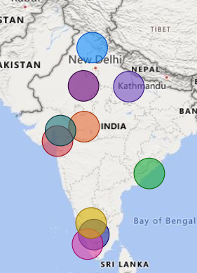
ABOUT
GOODCABS service locations
Jaipur
Kochi
Lucknow
Surat
Indore
Chandigarh
Visakhapatnam
Vadodara
Coimbatore
Mysore

Slide 5
ABOUT
Goal of this dashboard
Provide Actionable Insights: Analyze datasets to address key business questions on city-level trip performance, passenger trends, revenue patterns, and target achievement.
Support Decision-Making: Present findings in a clear and visually engaging manner to assist the Chief of Operations in making informed strategic decisions.

Slide 6
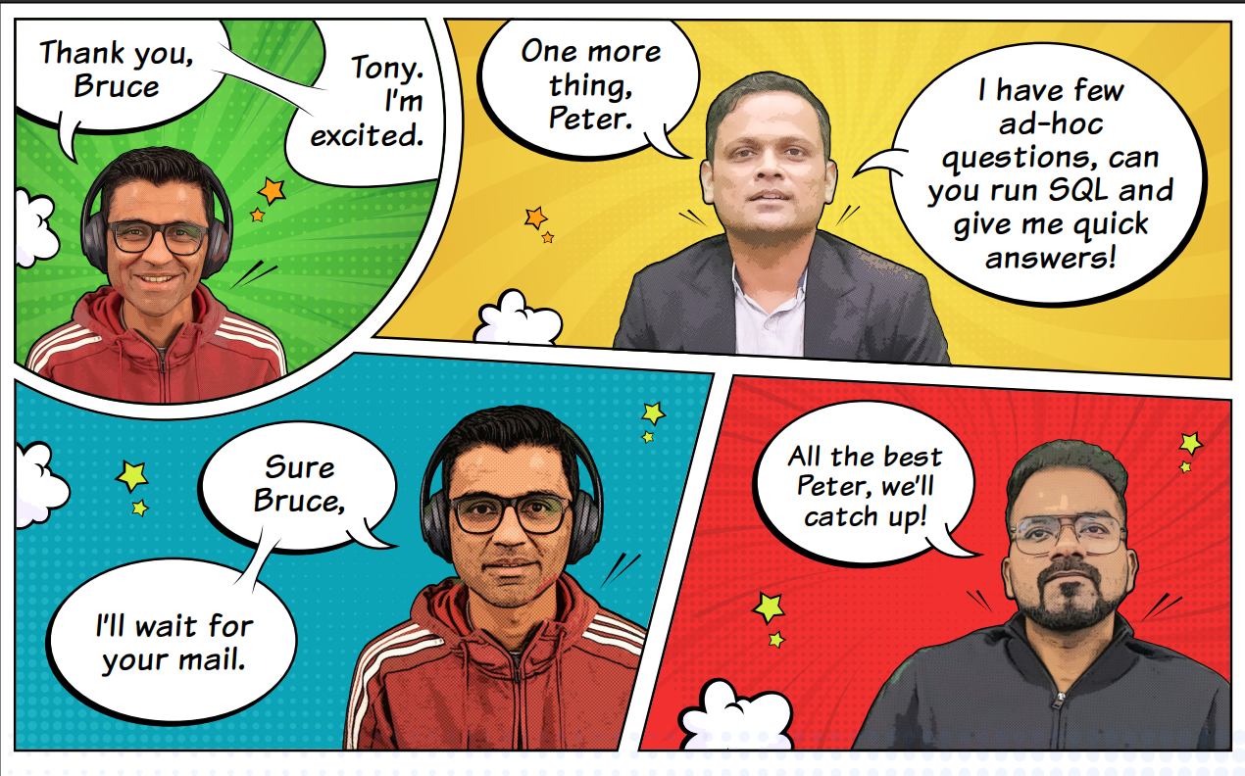
ABOUT
Goal of this dashboard

Slide 7
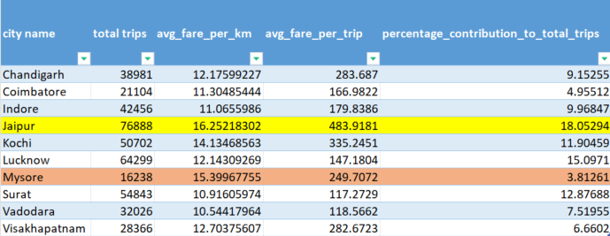
ABOUT
City level fare and trip summary report

Slide 8
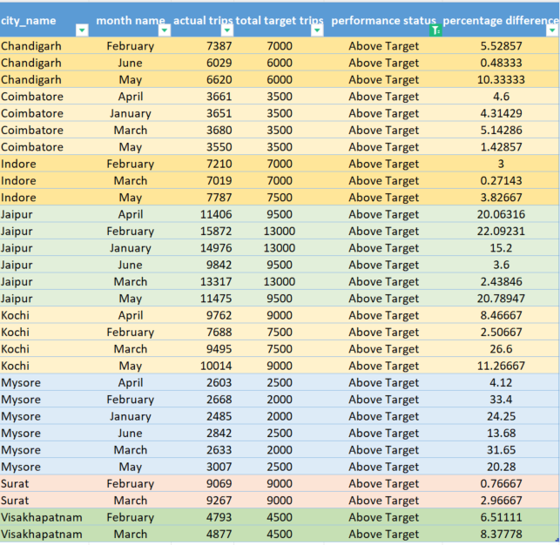
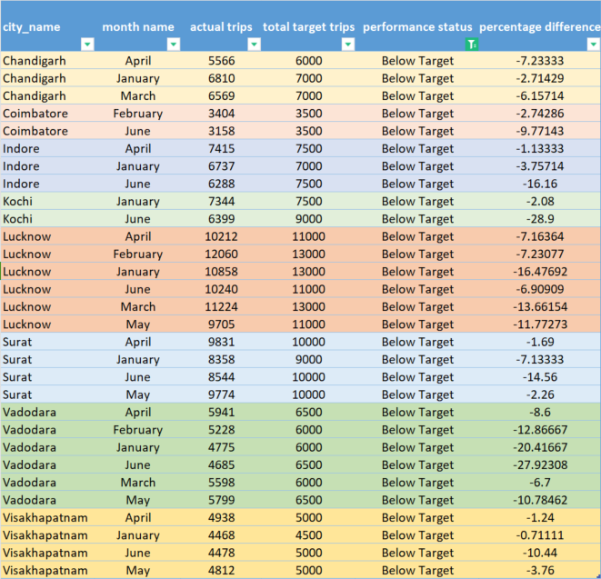
ABOUT
Monthly City - level trips target performance report

Slide 9
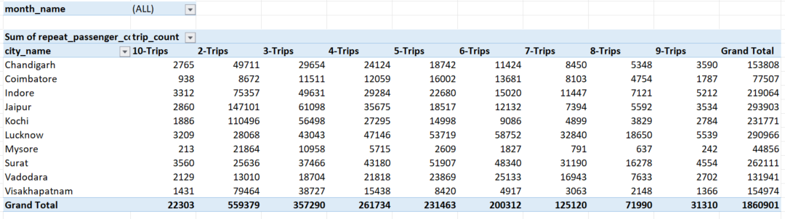
ABOUT
City level repeat passenger trip frequency report

Slide 10
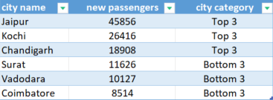
ABOUT
City with highest/lowest new passengers

Slide 11
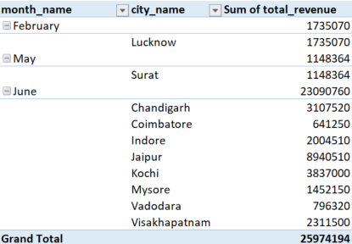
ABOUT
Month with highest revenue for each city

Slide 12
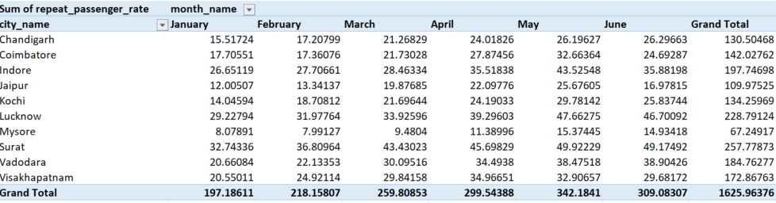
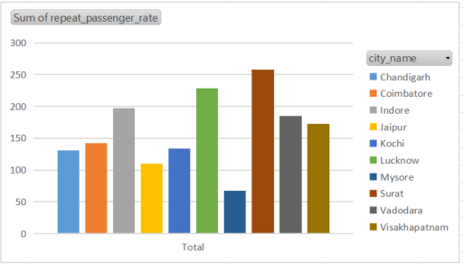
ABOUT
Repeat Passenger Rate Analysis

